Slide 1
INTERNSHIP REPORT
Industrial Manufacturing
& Process Optimization
Acrylic Adhesive & Specialty Tape Manufacturing Facility
Presented by: Anuraj Kumar
Roll No: 25scs1003001412 | Branch: B.Tech CSE | Batch: 2CSE7
IILM University, Greater Noida (Knowledge Park 2)

Slide 2

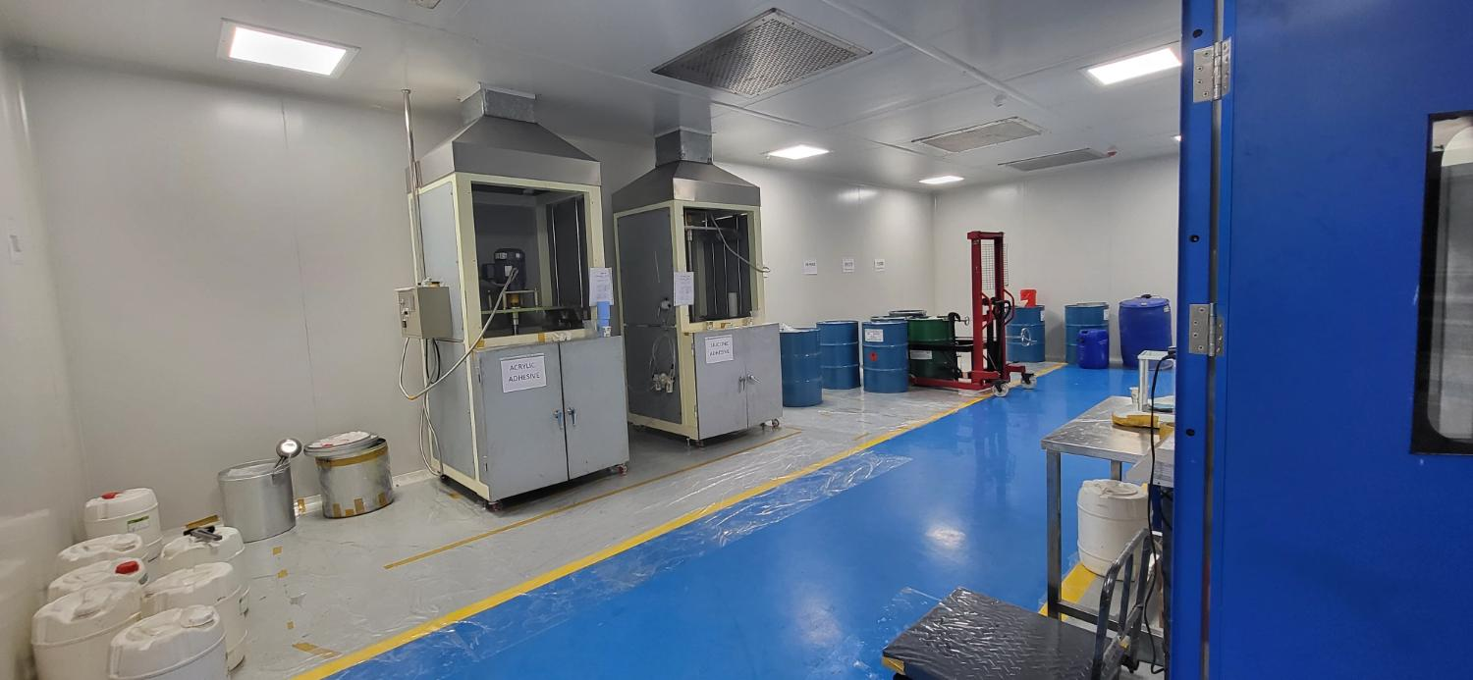
About the Company
Company Introduction
LOCATION
A leading manufacturer of acrylic adhesives, specialty tapes, and industrial films. The facility specializes in high-precision coating, laminating, and converting processes serving packaging, electronics, and automotive sectors.
F5, Block F, Surajpur Site V
Greater Noida, Uttar Pradesh 201312
India
Products & Services
Acrylic Adhesive Coating & Tapes
Specialty Film Conversion
Protective & Packaging Films
Custom Industrial Solutions

Slide 3

Internship Objectives
01
Understand Manufacturing Processes
Gain hands-on knowledge of adhesive coating, film conversion, and production workflows.
02
Data-Driven Decision Making
Apply Excel and analytical tools to track production metrics and identify inefficiencies.
03
Process Optimization
Identify and solve real-world problems such as material wastage on the shop floor.
04
Cross-Functional Exposure
Work across Sales & Marketing, Operations, and Quality to build holistic business understanding.

Slide 4






Department & Area of Work
Sales & Marketing
Data Analysis
Excel Handling
Market research, customer outreach, and product positioning support.
Production data tracking, KPI dashboards, and trend analysis.
Advanced spreadsheets for inventory, wastage logs, and reporting.
Social Media Mgmt
Product Listing
Process Improvement
Content support and digital presence enhancement for the brand.
Cataloging SKUs, specifications, and technical data sheets.
Shop-floor observation and continuous improvement initiatives.

Slide 5
Roles & Responsibilities
Daily Tasks Performed
Team Collaboration
Monitored production line data and logged key metrics in Excel
Assisted in inventory tracking of raw materials and finished goods
Supported sales team with product specifications and listings
Observed coating and winding machine operations
Prepared daily and weekly reports for supervisors
Coordinated with quality and production teams
Worked closely with production supervisors and machine operators
Participated in daily standup meetings and shift handovers
Collaborated with marketing on product photography & content
Supported data collection for continuous improvement projects
Mentored by senior engineers on process and quality standards
Cross-functional projects with packaging and dispatch teams

Slide 6
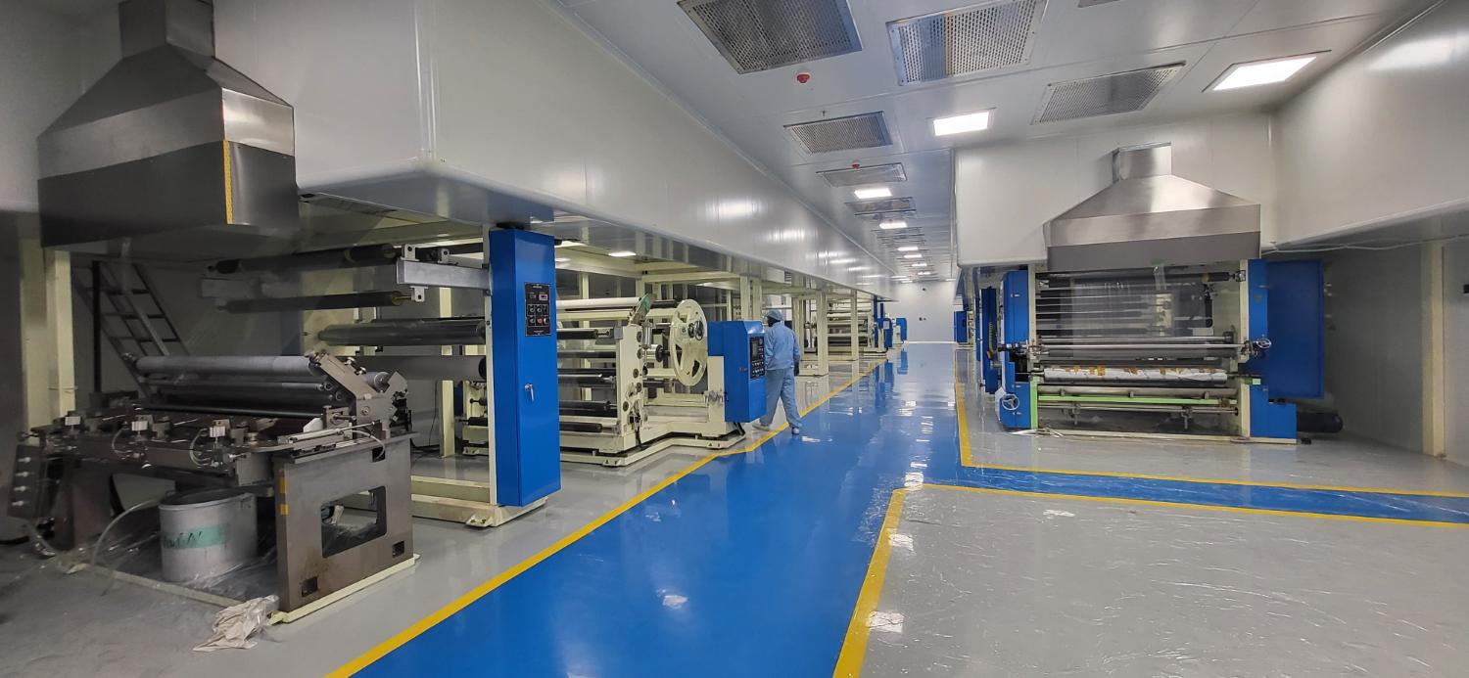
Work Done During Internship
Production Data Analysis
Built Excel trackers for daily output, downtime, and material consumption across coating lines.
Wastage Reduction Project
Identified root causes of printing material wastage and implemented a multi-die solution.
Product Catalog Support
Updated technical listings and assisted in creating accurate product data for customers.
Shop-Floor Observation
Documented process flows for adhesive coating, winding, and converting operations.

Slide 7
Problem Solved: Material Wastage Reduction
THE PROBLEM
THE SOLUTION
Significant wastage of printing material was observed during production runs due to inefficient die usage and frequent changeovers, leading to higher costs and material loss.
Implemented a six-die configuration system that optimized material usage, reduced changeover time, and minimized scrap generation during printing and coating operations.
Benefits to the Company
↓
↑
₹
✓
Material Wastage
Process Efficiency
Cost Savings
Quality Consistency
Significant reduction
Faster changeovers
Lower scrap costs
Better output control

Slide 8

Tools & Technologies Used
MS Excel
Data Analysis
Advanced formulas & pivot tables
Data validation & dashboards
Wastage tracking sheets
Production KPI reports
Trend identification
Root-cause analysis
Process capability insights
Visual reporting
Social Media Platforms
Shop-Floor Tools
Content planning support
Product showcase posts
Engagement tracking
Brand consistency
Machine parameter logs
Quality check sheets
Inventory systems
Process documentation

Slide 9

Skills Learned
1
2
3
Communication
Teamwork
Problem Solving
Effectively coordinated with operators, supervisors, and cross-functional teams on the shop floor.
Collaborated on multi-department projects and daily production targets.
Applied structured thinking to identify and reduce material wastage using the six-die approach.
4
5
6
Data Analysis
Process Knowledge
Professionalism
Transformed raw production data into actionable insights using Excel and analytical methods.
Gained deep understanding of adhesive coating, converting, and quality control processes.
Adapted to industrial work culture, safety protocols, and deadline-driven environments.

Slide 10

Challenges Faced & How I Overcame Them
Challenge: Understanding complex machinery
Solution: Spent extra time observing operators and asking detailed questions during shifts.
Challenge: Data inconsistency across logs
Solution: Standardized Excel templates and introduced simple validation checks.
Challenge: Fast-paced production environment
Solution: Prioritized tasks, maintained daily checklists, and adapted quickly to shift schedules.
Challenge: Technical terminology gap
Solution: Created a personal glossary and cross-referenced with process documentation.

Slide 11

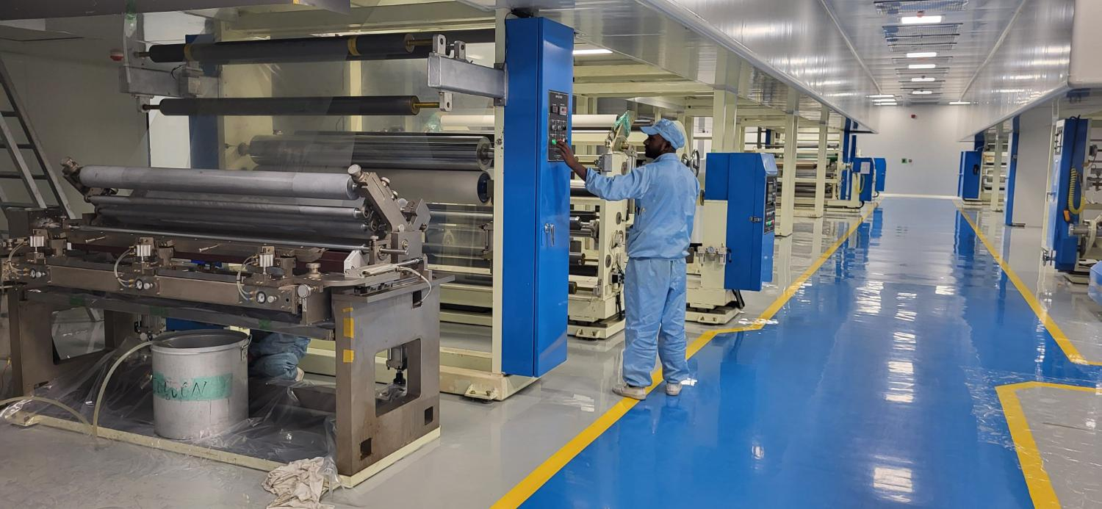
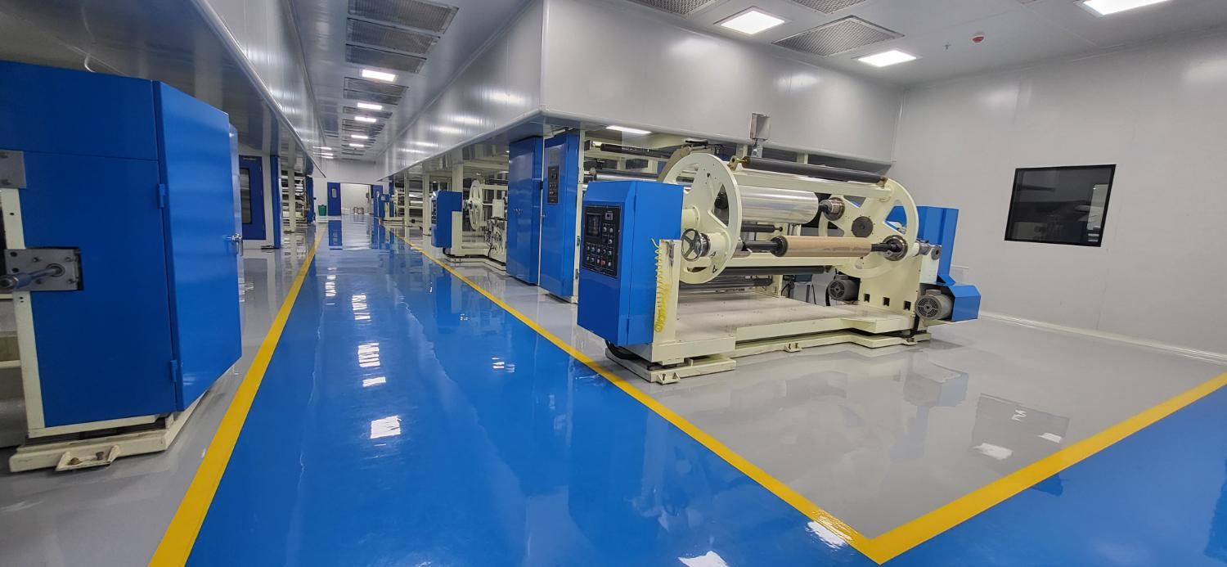
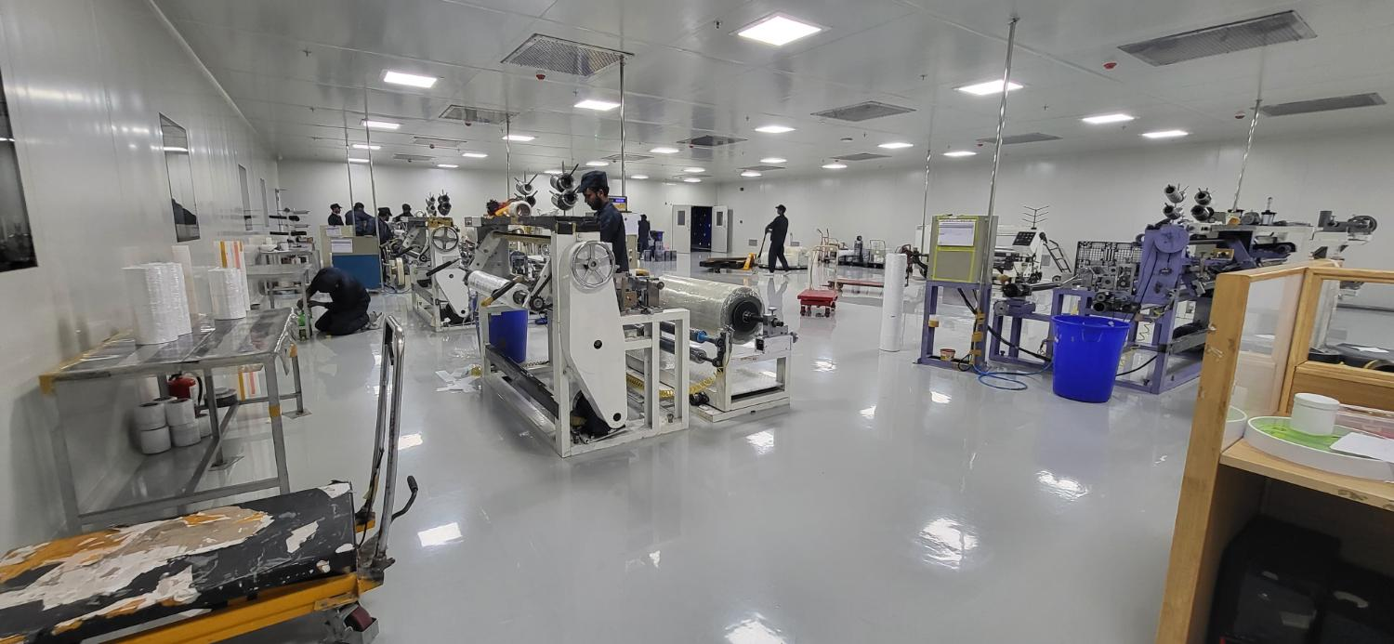
Internship Outcome & Factory Insights
Gained practical exposure to industrial manufacturing processes and quality systems.
Successfully contributed to a measurable reduction in printing material wastage.
Developed strong analytical and problem-solving skills applicable to real operations.
Built confidence in working within a professional industrial environment.

Slide 12

Conclusion & Acknowledgement
Summary of Experience
This internship provided an invaluable opportunity to bridge academic knowledge with real-world industrial practices. From understanding complex coating machinery to solving a tangible wastage problem using a six-die solution, every day contributed to my professional growth. The experience has strengthened my analytical mindset, teamwork abilities, and readiness for future challenges in manufacturing and operations.
Acknowledgements
The Company
My Mentor & Supervisors
College Faculty
For providing a structured internship and real project ownership.
For continuous guidance, patience, and constructive feedback.
For encouraging industry exposure and academic support.

Slide 13
Thank You
Questions?
Looking forward to your feedback and discussion.
Anuraj Kumar • B.Tech CSE • 2CSE7
IILM University, Greater Noida (Knowledge Park 2)

